Slide 1
Note to SeattleCoaches in Supervision, part 1 . . .
Whenever I have the chance to teach one of these, here’s what I have in my mind and heart:
I want to welcome people warmly and let them see my enthusiasm
I want to give them a clear overview of where we’re headed
I want to (briefly) tell then story of how and why coaching has become
* Important to me
* Important to leader effectiveness
Then I want to invite them to talk with me and each other about their experience of being coached: What worked?
Then I want to explain, illustrate and apply the Core Four Play Card (“How”)—asking them to note a potential area of growth
(Then a break)
Then I want to explain, illustrate and apply the Explore-Experiment Play Card
And then do a 7-8 minute demo with a volunteer
Following the demo, I will ask them to again note a potential area of growth
Then I want to explain, illustrate and apply the Coaching Leader’s Arena—asking them for a final time to note a potential area of growth
And finally, to choose an experiment and an accountability partner from the workshop
© Patricia Burgin, MA, www.seattlecoach.com
Notes:
This slides is a build.

Slide 2
Note to SeattleCoaches in Supervision, part 2 . . .
These are the best practices I like to include for maximum impact of this two-hour workshop:
Share the goals
Invite a key sponsor to introduce you and to endorse the workshop
Prepare and practice your personal “One Coach’s Story” (3-4 minutes)
In a pre-work email, ask participants to print hard copies of the three Play Cards
Ask table coaches to join you to help with breakout conversations
Do a demo after you introduce the first two Play Cards
Ask someone to be your coachee (in case no one volunteers)
Do a thorough overview of the Coaching Leader’s Arena, inviting members of the audience to find a next step
Make near the close sure you help people to identify both a next step and an accountability partner
Follow up within a day or two with additional coaching and training opportunities
© Patricia Burgin, MA, www.seattlecoach.com
Notes:
The leader/sponsor whom you’ll interview

Slide 3
Welcome
Where we’re headed
© Patricia Burgin, MA, www.seattlecoach.com
Notes:
The leader/sponsor whom you’ll interview

Slide 4
What does _________ think?
© Patricia Burgin, MA, www.seattlecoach.com
Notes:
The leader/sponsor whom you’ll interview

Slide 5
One Coach’s Story
© Patricia Burgin, MA, www.seattlecoach.com
Notes:
Your TED-ish talk

Slide 6
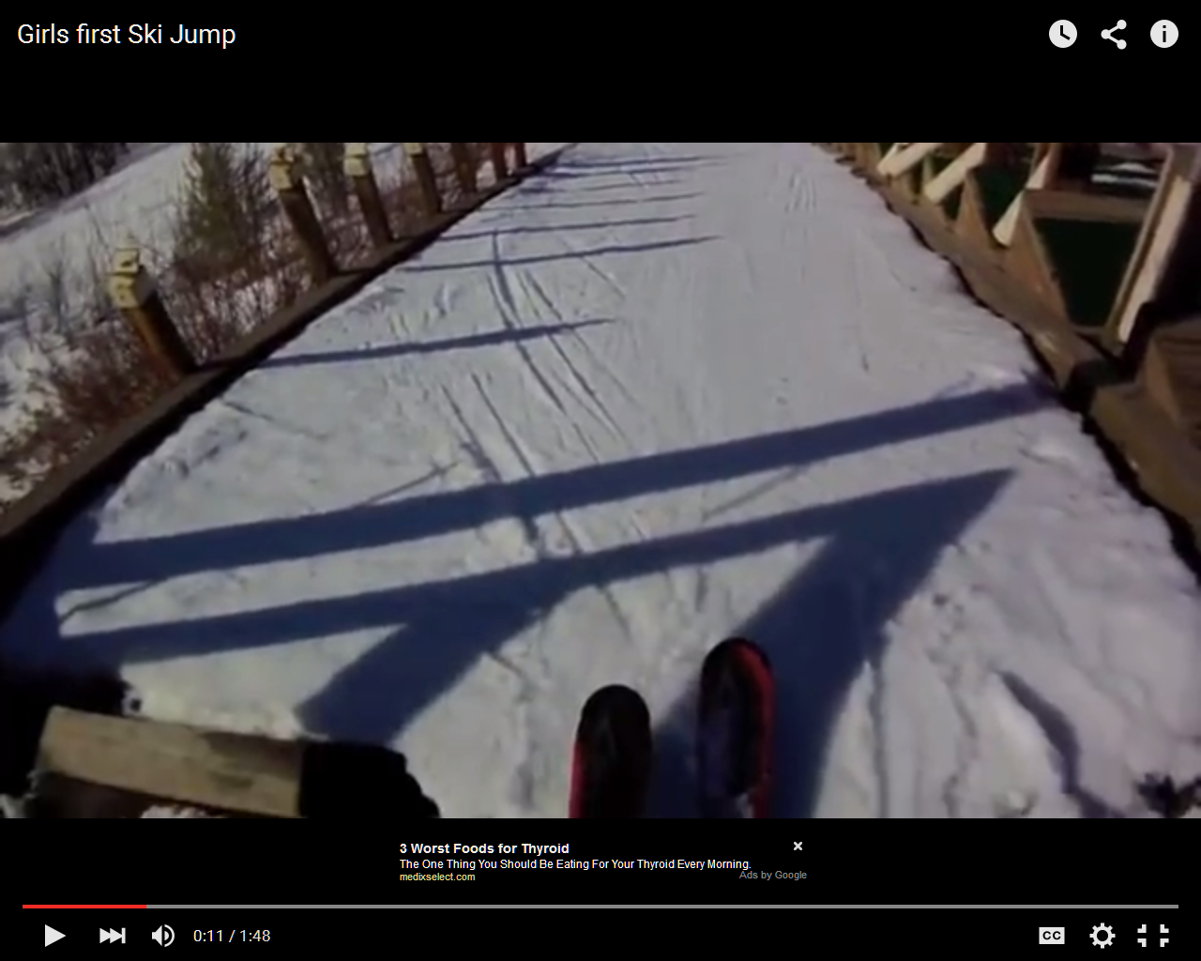
© Patricia Burgin, MA, www.seattlecoach.com

Slide 7
What do you notice in the skier’s process towards “safe enough”?
What do you hear in the energy of the coach in the background?
© Patricia Burgin, MA, www.seattlecoach.com
Notes:
This slides is a build.

Slide 8
The two big potential coaching errors:
To overuse your tendency to challenge
To overuse your tendency to comfort and support
© Patricia Burgin, MA, www.seattlecoach.com
Notes:
This slides is a build.

Slide 9
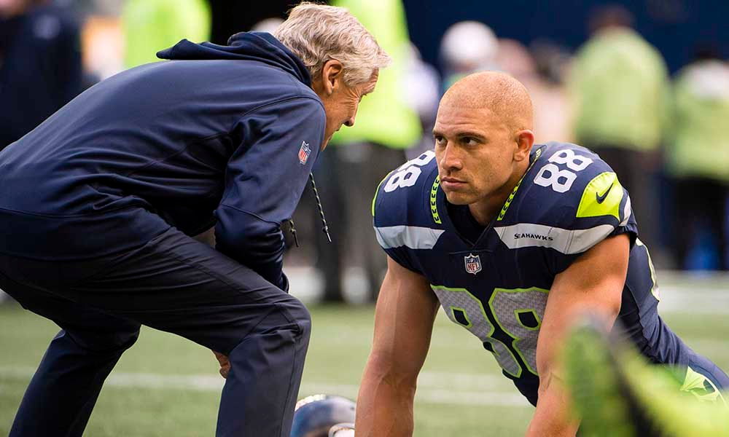
What’s going on here?
(You probably just made up a story)
© Patricia Burgin, MA, www.seattlecoach.com
Notes:
Assuming there is a lot of trust in the bank: Support? Challenge?

Slide 10
By small groups for a few minutes . . .
In your experience of being coached growing up
(in sports, musically, by a parent or relative . . . )
What was it about your relationship with your “coach” that worked for you? It might have been in a single, memorable conversation.
How did feedback work in the relationship?
© Patricia Burgin, MA, www.seattlecoach.com

Slide 11
In your experience of being coached
(in sports, musically, as a kid, as a professional . . . )
By breakouts/triads:
Each person tell a sixty-second story
Everyone else listens for what seems important
© Patricia Burgin, MA, www.seattlecoach.com

Slide 12
Notes:
Ask them to pull out their hard copies

Slide 13
A Five Minute Break
© Patricia Burgin, MA, www.seattlecoach.com

Slide 14
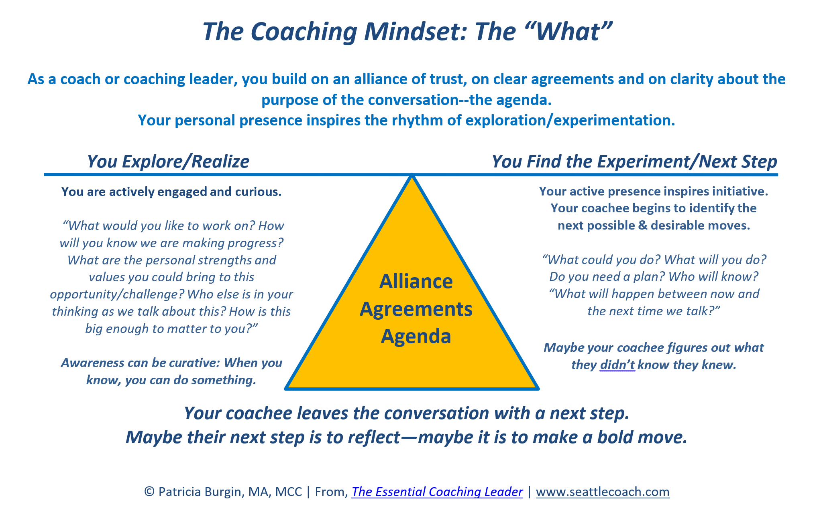
Notes:
Ask them to pull out their hard copies

Slide 15
An 8 Minute Demo
© Patricia Burgin, MA, www.seattlecoach.com

Slide 16
Notes:
Ask them to pull out their hard copies

Slide 17
The Gold Line: Your Company’s Coaching Culture
(if you’re lucky)
© Patricia Burgin, MA, www.seattlecoach.com

Slide 18
The Blue Line: Your Coaching Presence
(even when you’re giving direction)
© Patricia Burgin, MA, www.seattlecoach.com

Slide 19
By Breakouts/Triads
Which quadrant do you think tends to be your “default”leadership quadrant?
What is something you’d like to get better at? (A 10% shift)
Where, when and with whom could you experiment in the coming week?
© Patricia Burgin, MA, www.seattlecoach.com
© Patricia Burgin, MA, Master Certified Coach. SeattleCoach LLC.
Notes:
Make a note.

Slide 20
Next Steps?
Q. What have you noted these past two hours as potential experiments as a coaching leader?
Take one minute of silence to review your personal nominees—and to select one.
© Patricia Burgin, MA, www.seattlecoach.com

Slide 21
Index fingers up
(Who will know about your experiment?)
© Patricia Burgin, MA, www.seattlecoach.com
Notes:
When we’re in-person, I ask participants to point to someone in the room. Virtually, I ask them to find their name under “participants” and then to “rename” themselves with the name of the person they will check in with in the coming week.

Slide 22
© Patricia Burgin, MA, www.seattlecoach.com

Slide 23
Next Steps:
Check in with that person you pointed to in the coming week.
Read this “brief book about a big deal” www.pattyonamazon.com
More info to come about coach training opportunities
© Patricia Burgin, MA, www.seattlecoach.com
Notes:
Under #3, tell them about the training we do inside of organizations, CFL https://www.seattlecoach.com/coaching-for-leaders.html, and the even more in-depth training we do with individual coaching leaders https://www.seattlecoach.com/coach-training.html. Let them know that in your follow-up email, you’ll send info about both.

Slide 24
The SeattleCoach Toast
“To journey without being changed is to be a nomad.
To change without journeying is to be a chameleon.
To journey and be transformed by the journey is to be a pilgrim.”
-Mark Nepo
© Patricia Burgin, MA, www.seattlecoach.com
Notes:
This slides is a build.

